Slide 1
MWGaiaDN Tech Workshop
Institute of Astronomy, University of Cambridge
15th July 2025

Slide 2
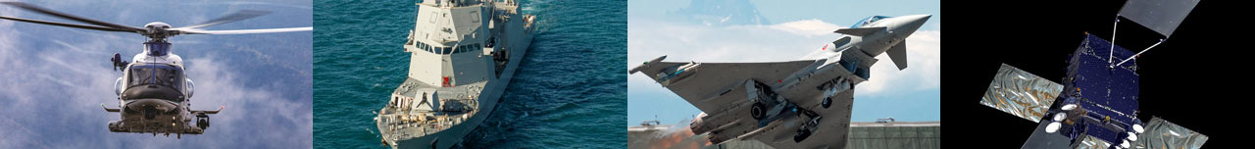
INTRODUCTION
Our group
Leonardo is a global company that develops multi-domain operational capabilities in the Aerospace, Defence and Security sector, with an integrated offer of high-technology solutions for military and civil applications.
Helicopters
Defence Electronics & Security
Aeronautics
Space
Helicopters Division
PZL-Şwidnik (100%)
Kopter (100%)
Leonardo UK/Helicopters (100%)
NH Industries (32%)
Electronics Division
Cyber & Security Solutions Division
Electronics Division
Cyber & Security Solutions Division
Leonardo DRS (80.9%)
Leonardo UK/Electronics/Cyber (100%)
MBDA* (25%)
Hensoldt (25.1%)
Elettronica (31.3%)
Larimart (60%)
Aircraft Division
Aerostructures Division
ATR* (50%)
Telespazio* (67%)
Thales Alenia Space* (33%)
AVIO (29.6%)
* Joint ventures % Leonardo’s share

Slide 3
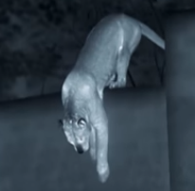
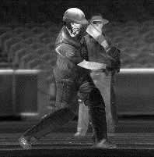
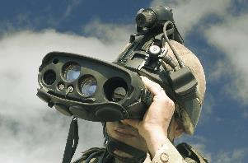
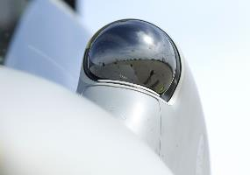
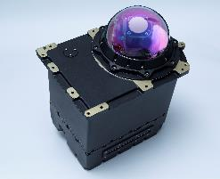
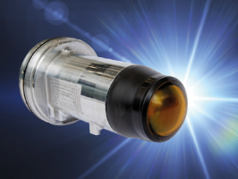
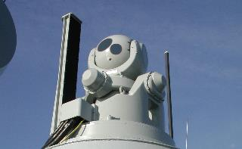
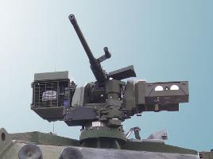
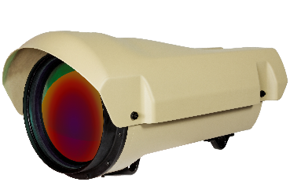
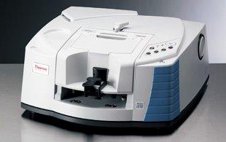
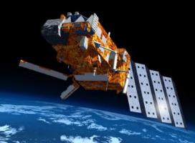
Leonardo UK - Detector Capability
Leonardo UK Detectors based in Southampton in the UK is a growing business with a long-term commitment to the manufacture of world-class infrared sensors. Science and astronomy arrays use the same production facilities as standard thermal imaging detectors and share the same high quality, high yield process. Leonardo is therefore a reliable, long-term supplier of infrared detectors to the science community.
Thermal Imaging
Handheld imagers
Airborne tracking
DIRCM
Missile Seekers
Naval IRST
Vehicle Sighting
Long Range Surveillance cameras
Infrared spectroscopy
Space and Astronomy
Science business area
Notes:
Thermal Imaging
Handheld thermal imagers
UAV imagers
Surveillance
Airborne tracking systems
Naval IRST
Commanders/gunners/aiming sights
Remote operated weapon stations
Fire control stations
Missile Guidance
Infrared spectroscopy
Space flight programmes
Astronomy

Slide 4
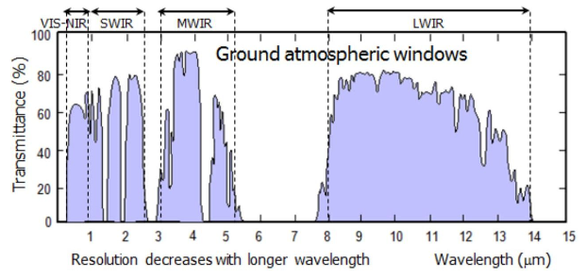
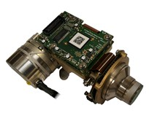
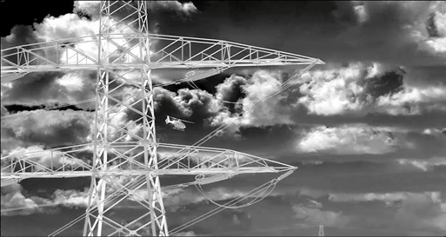
Technology: MCT Detectors
APD 2D detectors
MCT Detectors
One technology/process covers whole IR spectral range
Wafer scale process on 4” GaAs substrates for low cost
Offer high performance SW (0.8 – 3), MW (3-5), LW (8-11.5µm)
Broadband and Dual Colour
Highest performance detector material available
Avalanche Photo-diodes (APDs) Arrays
High, noise-less gain in each pixels.
Capable of high speed photon counting
Spectral range 1.5-2.5um (0.4-2.5µm and MWIR on roadmap)
Suits low flux applications - scientific, optical communication and long range LiDAR
PV 2D detectors
PV + PC detectors
SuperHawk MWIR imagery (1280 x 1024/8µm)

Slide 5
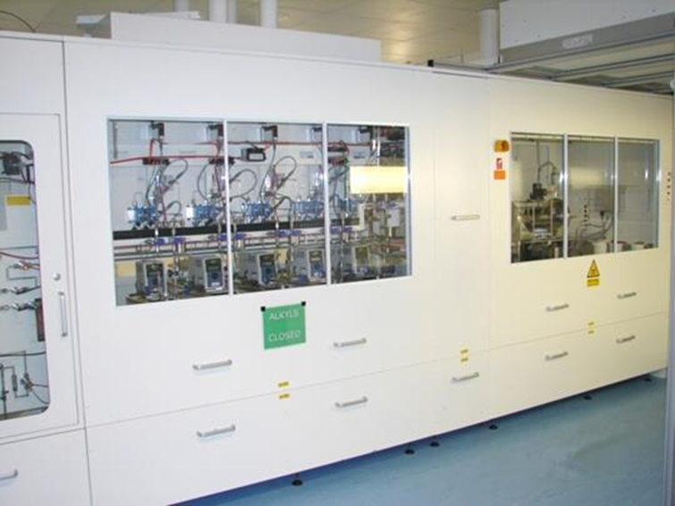
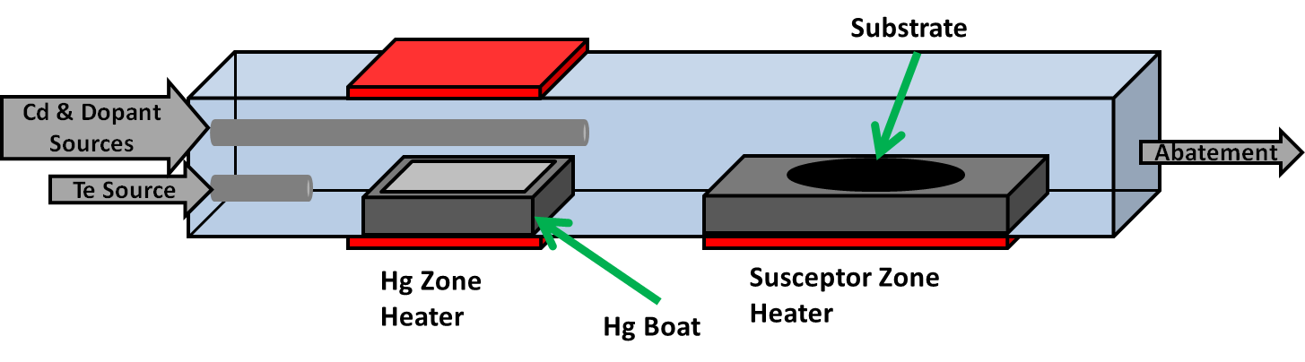
MCT MOVPE Growth Capability
  Leonardo UK is the only detector manufacturer that uses Metal Organic Vapour-Phase Epitaxial growth on a low-cost substrate.
  Excellent uniformity, morphology
  MCT Wafer level process 4”
  Low cost GaAs substrate
  Alternate HgTe and CdTe growth
  Same growth conditions for all compositions SW, MW,LW, DWB, APD

Slide 6
MCT MOVPE Wafer Scale Capability
Wafer-scale processing allows for multiple array formats on each wafer. This example is for 16 Ike Pono 1kx1k/15µm die along with 16 Saphira 320x256/24µm die. Other areas for in-line quality checks.
Wavelength and hillock defect mapping
100mm GaAs wafer

Slide 7
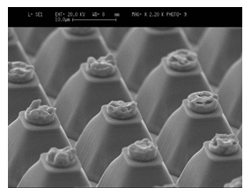
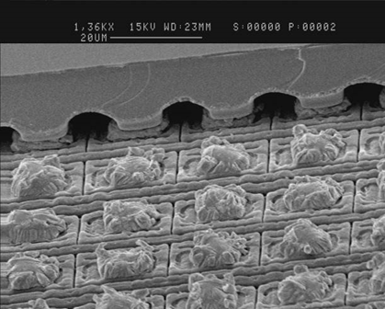
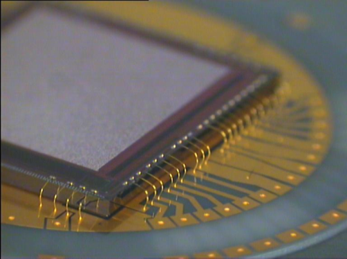
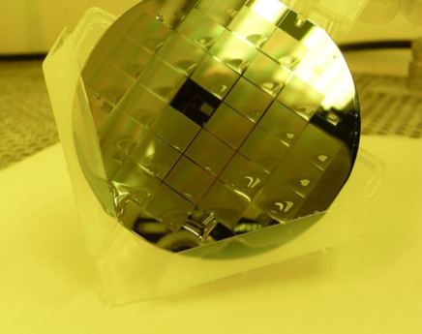
MCT MOVPE Wafer Scale Capability
MCT epi wafer on GaAs substrate
MCT mesa process
Bump bond die + substrate removal
Wafer Fab
Read out integrated circuit (ROIC)
Diodes have negligible interpixel capacitance and crosstalk. The pixel has optical concentration and the minimum volume for low dark current

Slide 8
Leonardo APD Architecture
Leonardo e-APD solutions
The standard 0.8-2.5um product offers high gain
The high speed 1.45-2.5um product offers 100% internal QE and GHz response
Strengths:
Low p-n junction capacitance
The mesa slot structure provides for very low p-n junction and inter-pixel capacitance. Both essential for sensitivity.
Imaging quality
The mesa structure and 100% absorption ensures that crosstalk is negligible. Unlike other device structures there is no mechanism for thermal diffusion to another pixel.

Slide 9
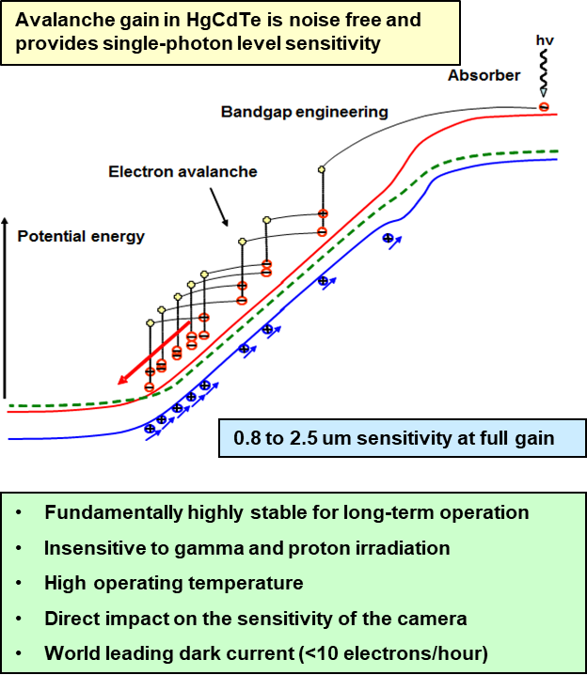
Leonardo APD Technology
Disruptive technology
Gain in pixel (up to few 100)
Enables read noise < 1e-
Enables high speed imaging with high SNR
New generation of detectors
  Very low background (Hz imaging) for Astronomy
  High speed (kHz imaging) for
  LIDAR/3D Imaging
  TDI Imaging
  Photon counting
  Optical comms
MOVPE MCT is ideal material for APD

Slide 10
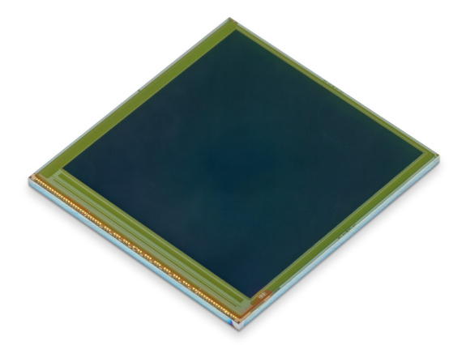




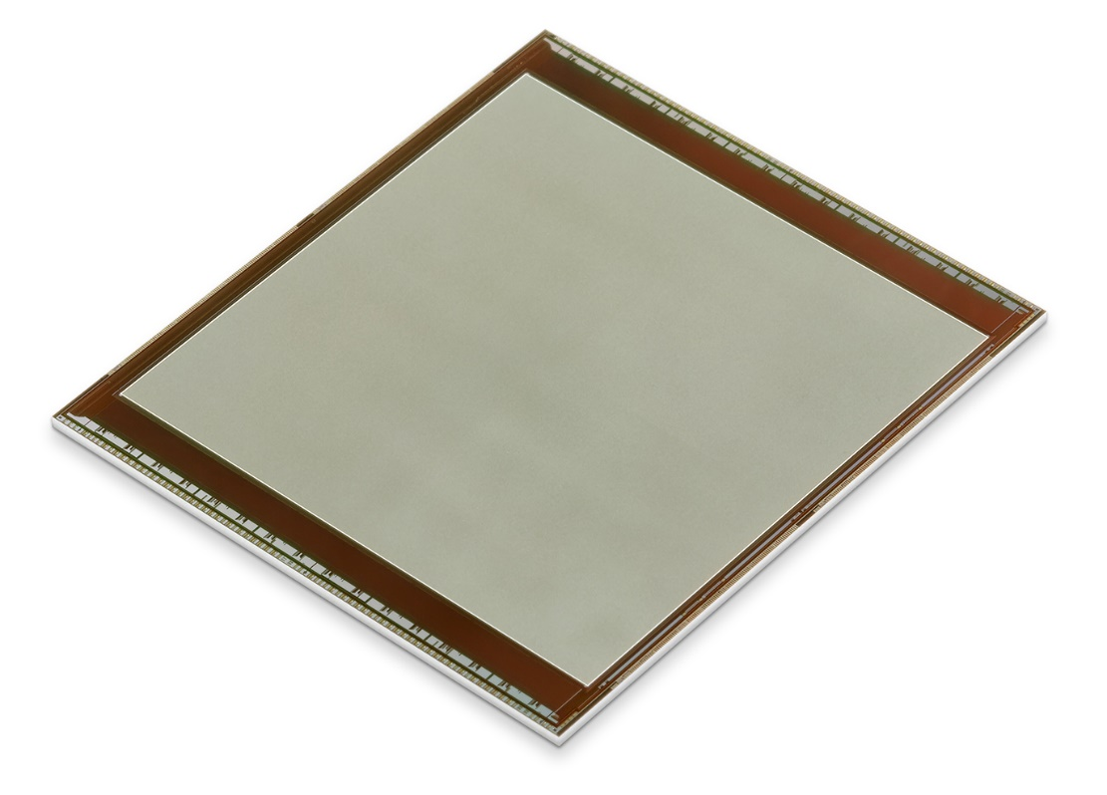
Leonardo APD focal plane arrays for low background flux applications
Initial development in collaboration with University of Hawai’i, Institute of Astronomy under NASA ROSES project.
Initial development and low-background flux APD assessment on ‘Ike Pono’
Named by the late Don Hall – Hawaiian for ‘far seeing’
2kx2k FPA funded by European Space Agency – called ‘IBEX’
Further funding for 2kx2k development from UoH and ESA to refine performance under low flux conditions
Ike Pono 1024x1024/15µm
IBEX
2048x2048/15µm

Slide 11
GAIA detector considerations

Slide 12
Leonardo Detector Considerations
TDI Scan direction
CCD
IR Detector
Star field shifted by 1 pixel
Frame N
Frame N + 1
Read out
Integration time up to few msec
Readout whole frame
Pseudo TDI by off chip processing
Challenges
Flux range – mag 6 down to mag 20 or lower
Variable integration time
Signal to noise for few msec integration time
Need to detect signal photons
Integration time up to few sec
Readout 1 column per frame
Challenges
Flux range – mag. 6 down to mag. 20 (5E5 range)
Variable TDI length
Radiation charge trapping

Slide 13
Leonardo Detector Considerations
Silicon
Gaia-NIR hybrid architecture
Latest view on sub-module architecture
(Assume 3ms TDI dwell time)
For 2048 pixels across-scan
No. of outputs: 16 at 5MHz
Over-range detector pixels
(4 pixels)
Analogue readout (1 frame per TDI shift)
MCT
APD array
Over-range detector block
100 pixels
tbc
2048 pixels
tbc
10µs 50µs 250µs 1ms Full integration time
Common contact

Slide 14
Leonardo Detector Considerations
Technical Challenges
Photon level sensitivity required
APD gain >200
Suppressed APD noise sources
Manufacturability Challenges
Gaia is potentially a huge project depending on architecture selected
Yield challenges of larger arrays
Needs to fit into commercial business alongside other contracts
Conclusions
An attractive but challenging programme
Further de-risking activities to develop full photon level detection
Trade-off sensitivity with array size/TDI length

