Slide 1
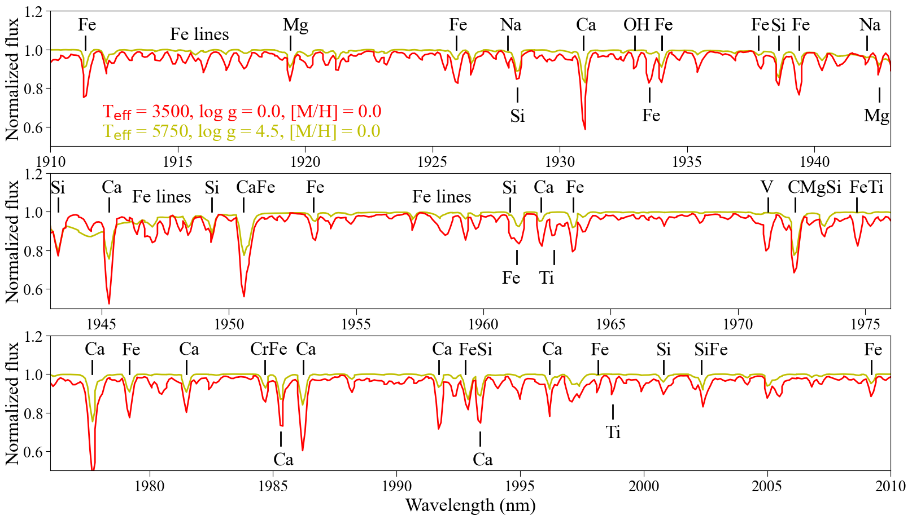
Radial velocity calculations for GaiaNIR
Mészáros Szabolcs (meszi@gothard.hu)
ELTE Gothard Astrophysical Observatory, Hungary
Konkoly Observatory, Hungary
2025-07-15

Slide 2
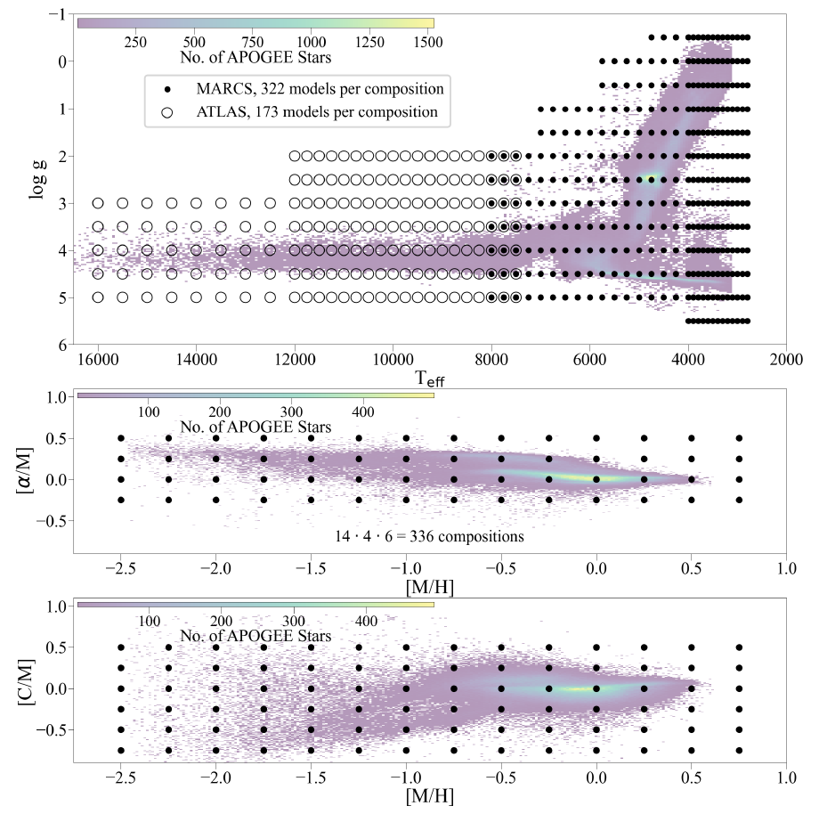
The BOSZ database
The modeling of stellar spectra of flux standards observed by the Hubble and James Webb space telescopes requires a large synthetic spectral library that covers a wide atmospheric parameter range.
Mészáros, Sz. et al. 2024, A&A, 686, 197: The updated BOSZ synthetic stellar spectral library : https://archive.stsci.edu/prepds/bosz/
336 compositions, spectra between 50 nm and 32 μm. These new local thermodynamic equilibrium (LTE) models incorporate both MARCS and ATLAS9 model atmospheres, updated continuous opacities, and 23 new molecular line lists.

Slide 3
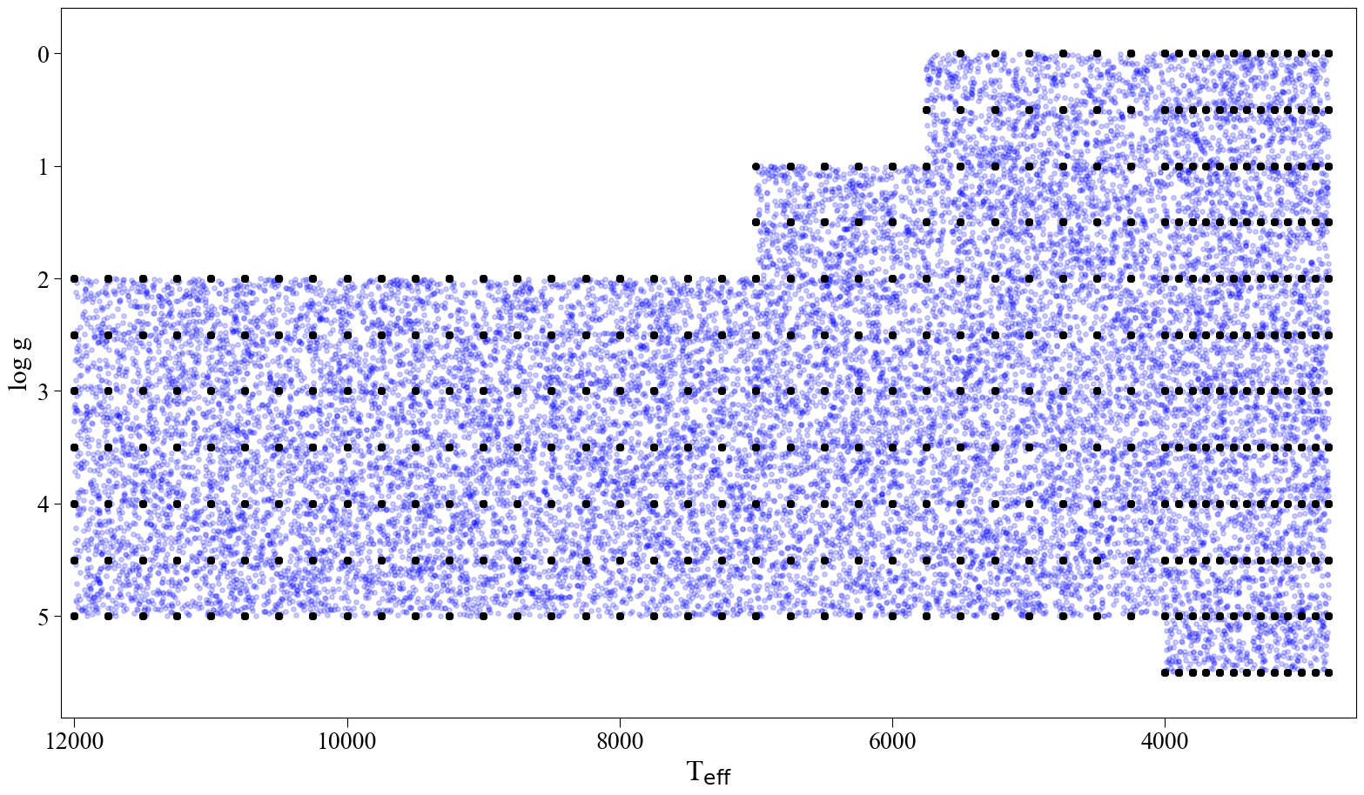
Parameters of calculations
Is there a 100 nm wide wavelength region that provides precise enough radial velocities in the mid-IF?
20000 synthetic spectra with random T_{eff}, log g and [M/H].
Assigned random v_{rad} between –100 and 100 km/s.
SNR from 10 to 100 with Gaussian noise pattern.
Running pyasl.crosscorrRV from –150 and 150 km/s, template is the spectrum without any noise.
The median and scatter of the differences were calculated of stars for which the difference did not exceed ± 50 km/s to eliminate erroneous measurements.

Slide 4
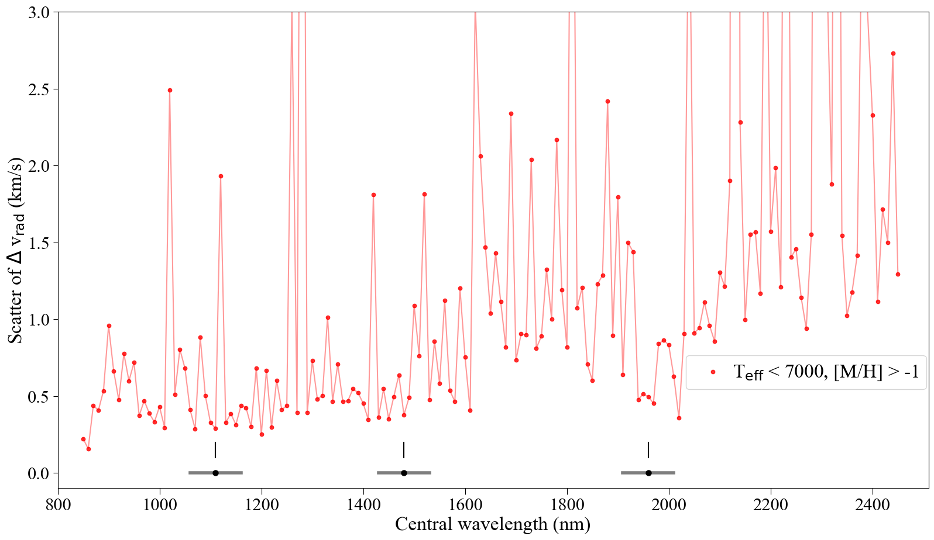
The scatter vs. central wavelength

Slide 5
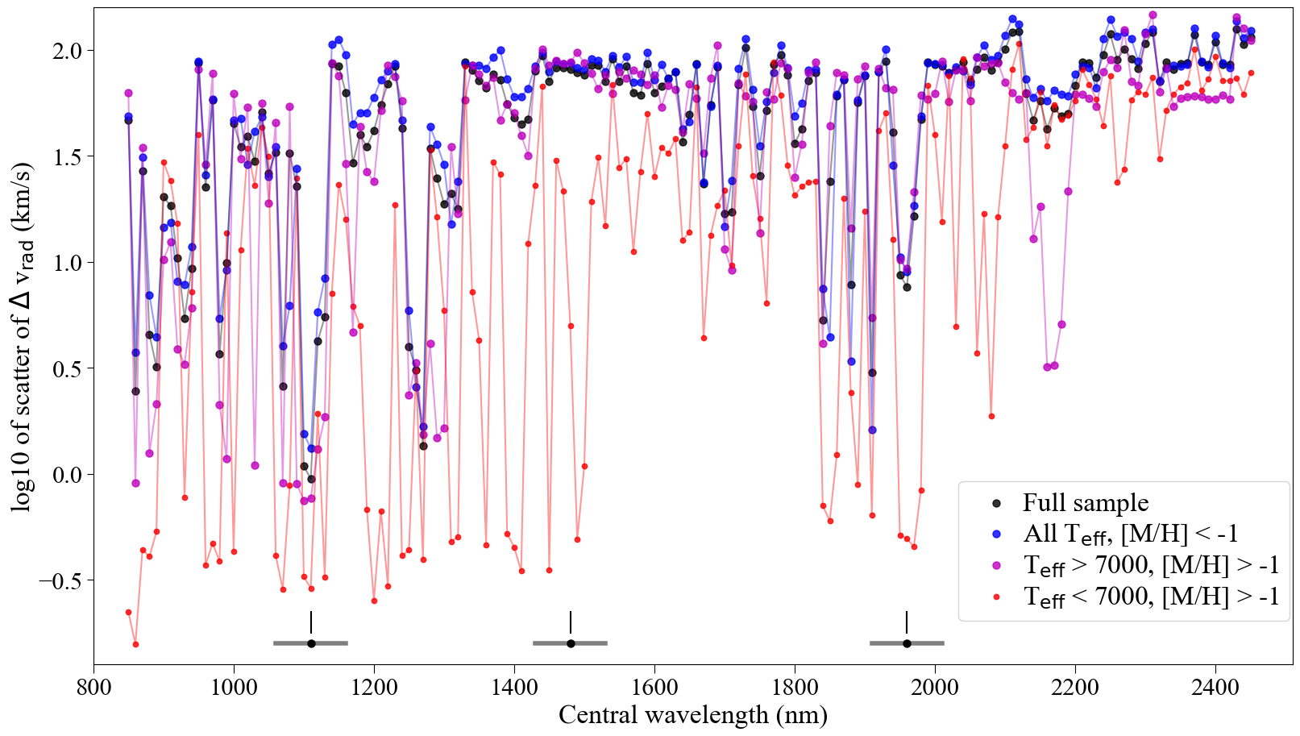
The scatter vs. central wavelength

Slide 6
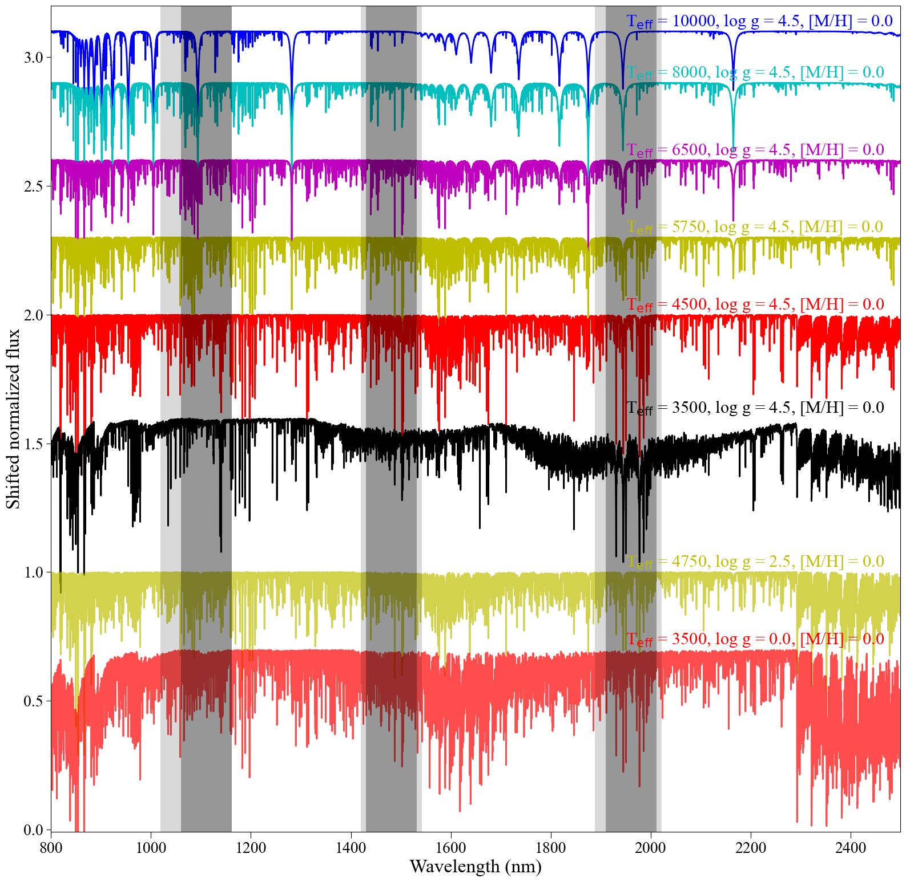
Selected windows
Three windows selected:
1910 – 2010 nm: preferred region, strong Fe and Ca lines across a large parameter space. A factor of two less precise than the 1060 – 1160 nm region.
1430 – 1530 nm: backup region, strong Fe, Ca, Mg lines, no v_{rad} possible above ~10000K.
1060 – 1160 nm: this is the most precise region; however, it is not at sufficiently longer wavelength than Gaia’s spectrograph.

Slide 7
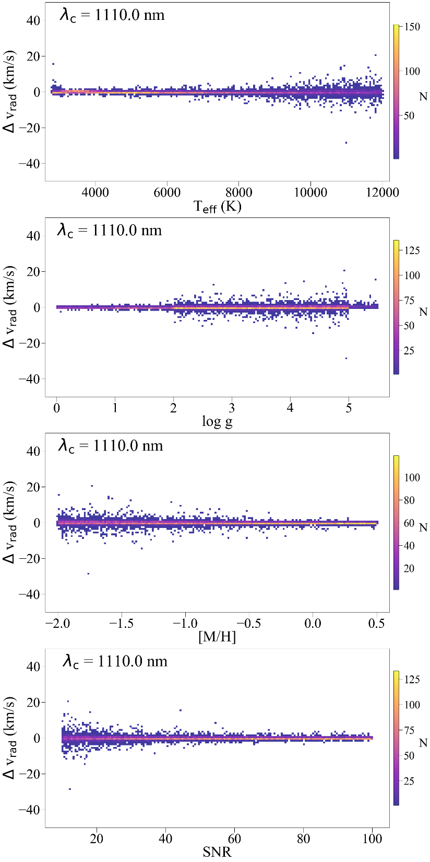
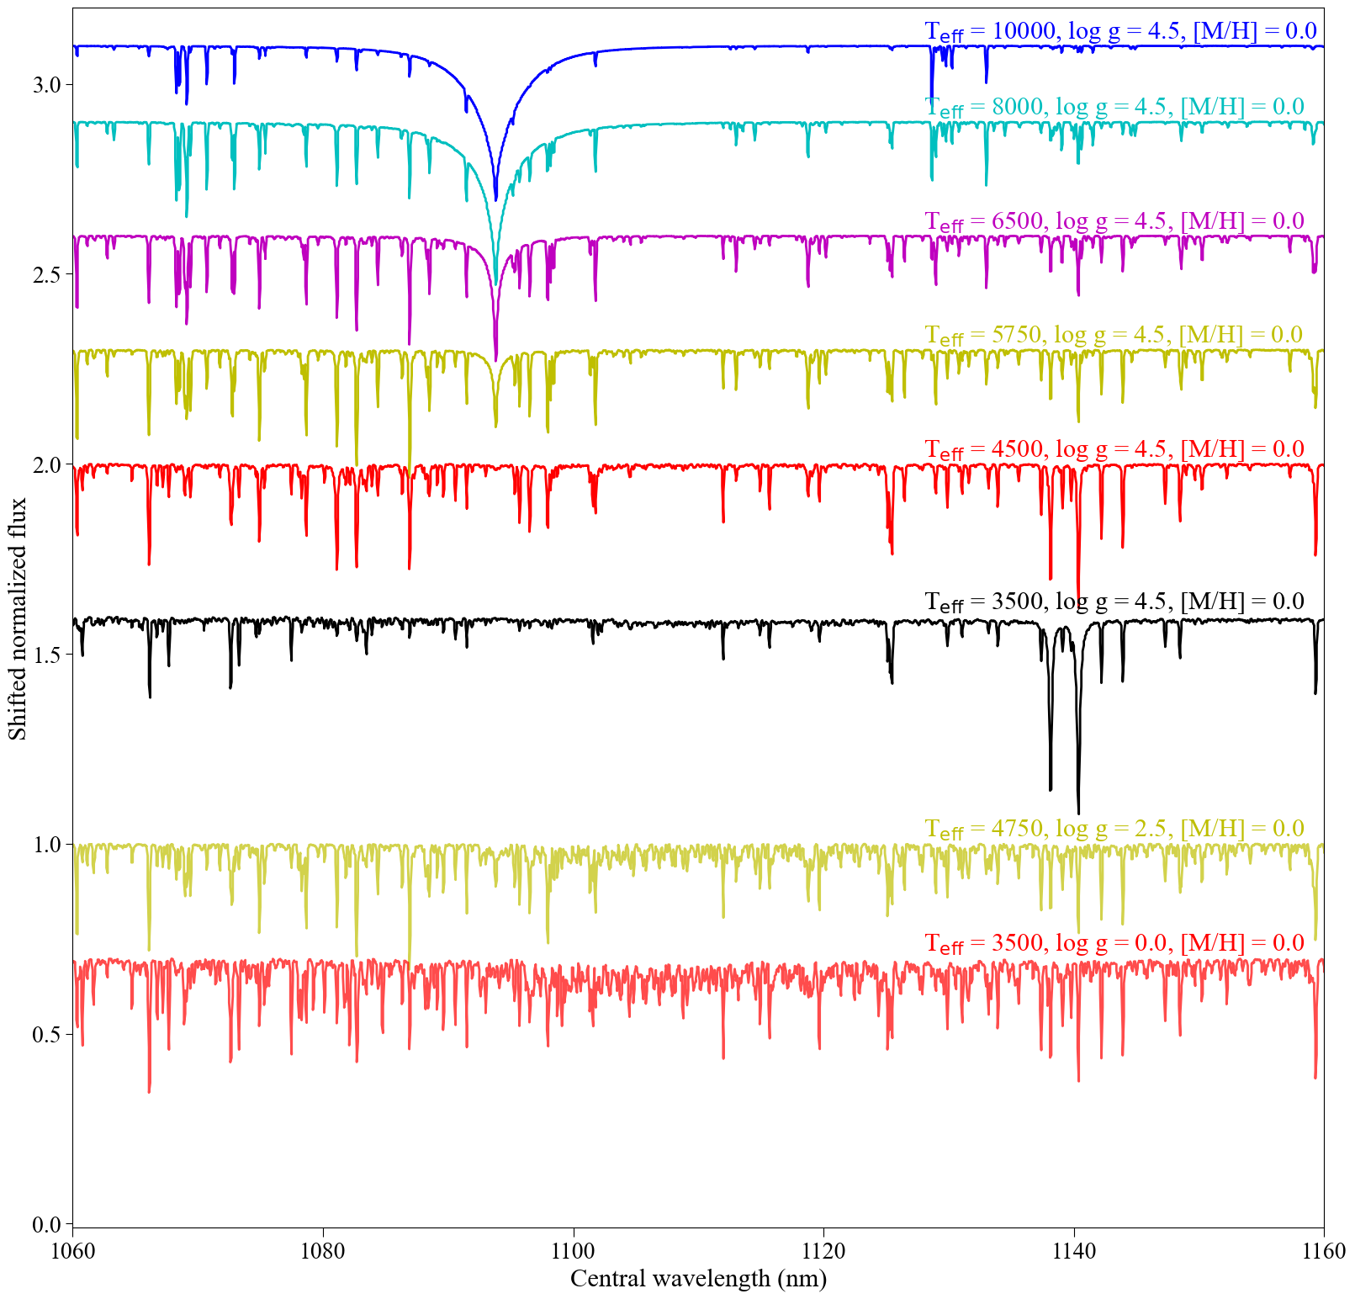

Slide 8
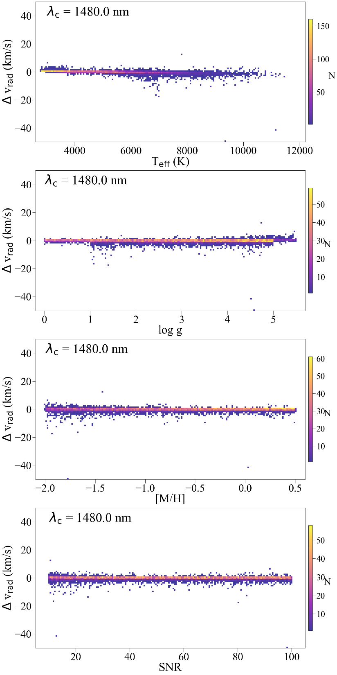
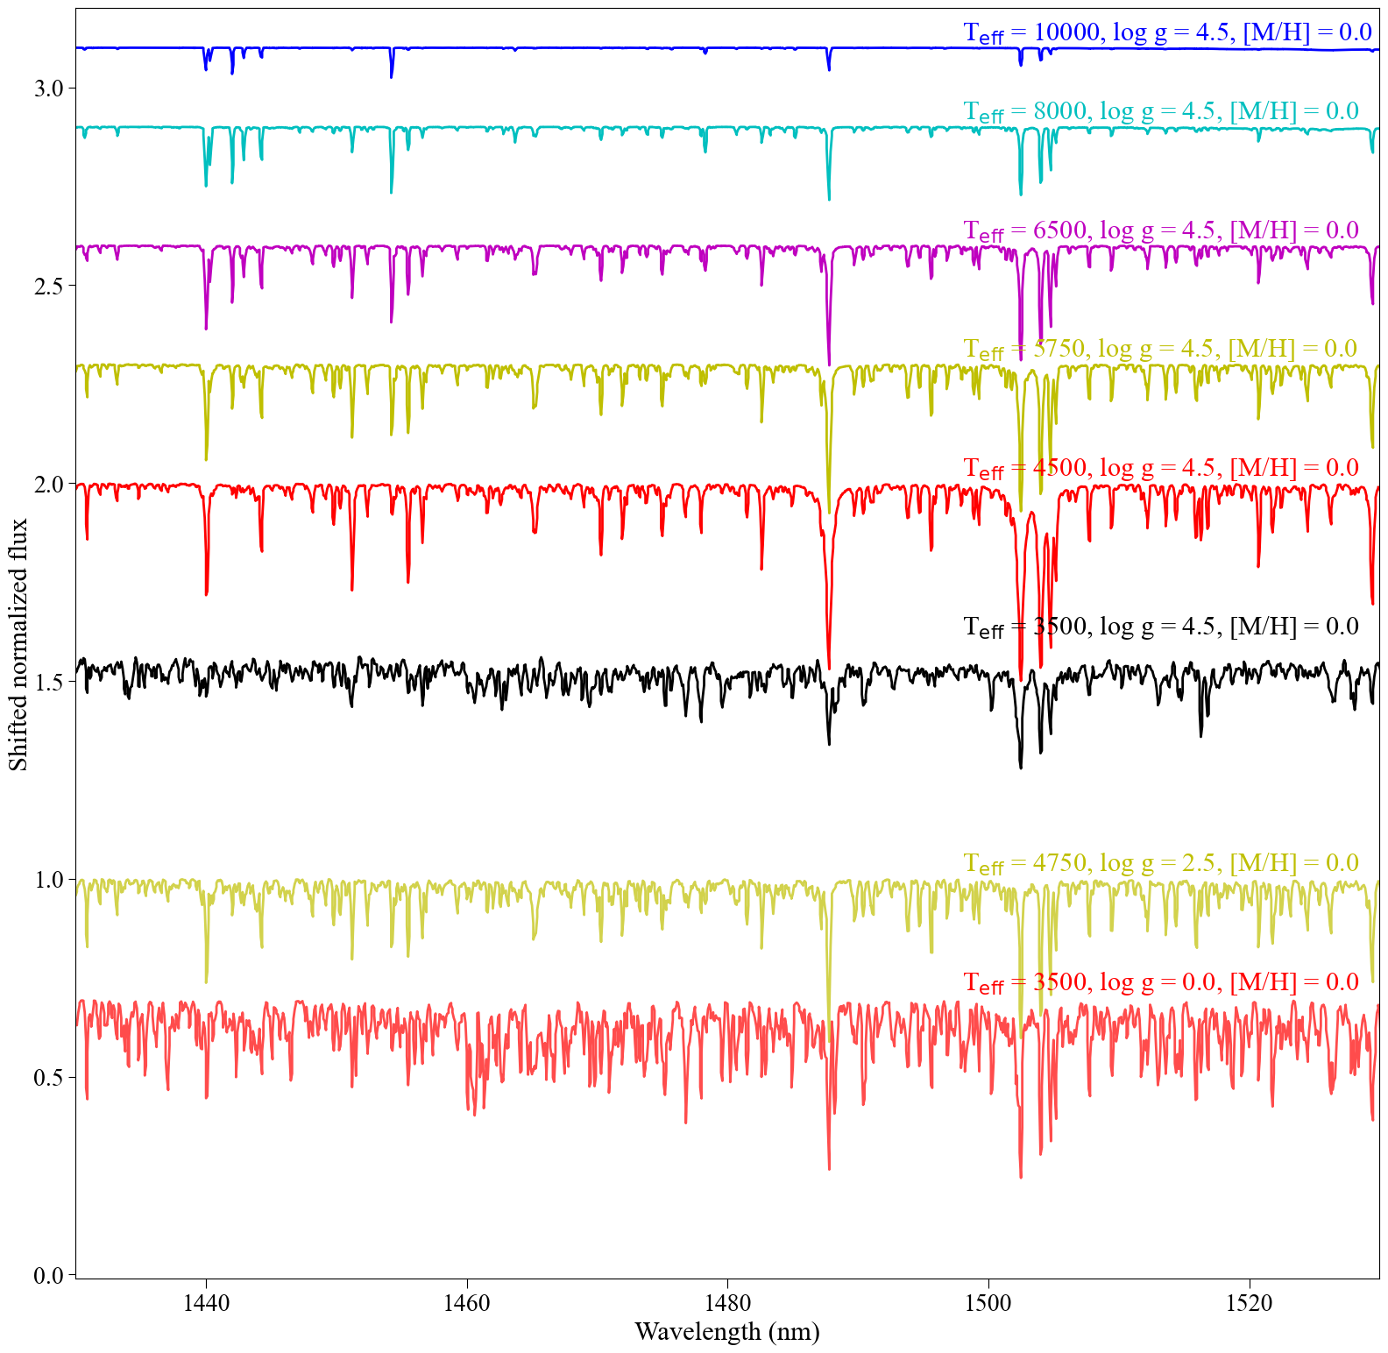

Slide 9
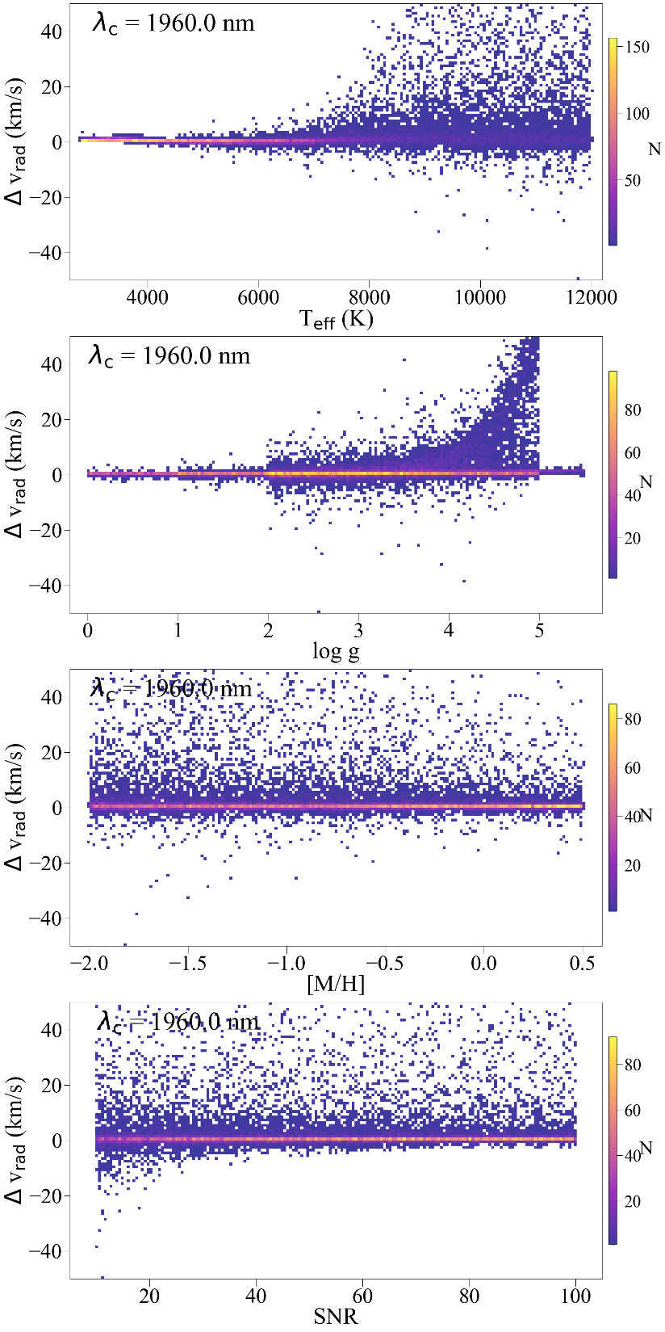
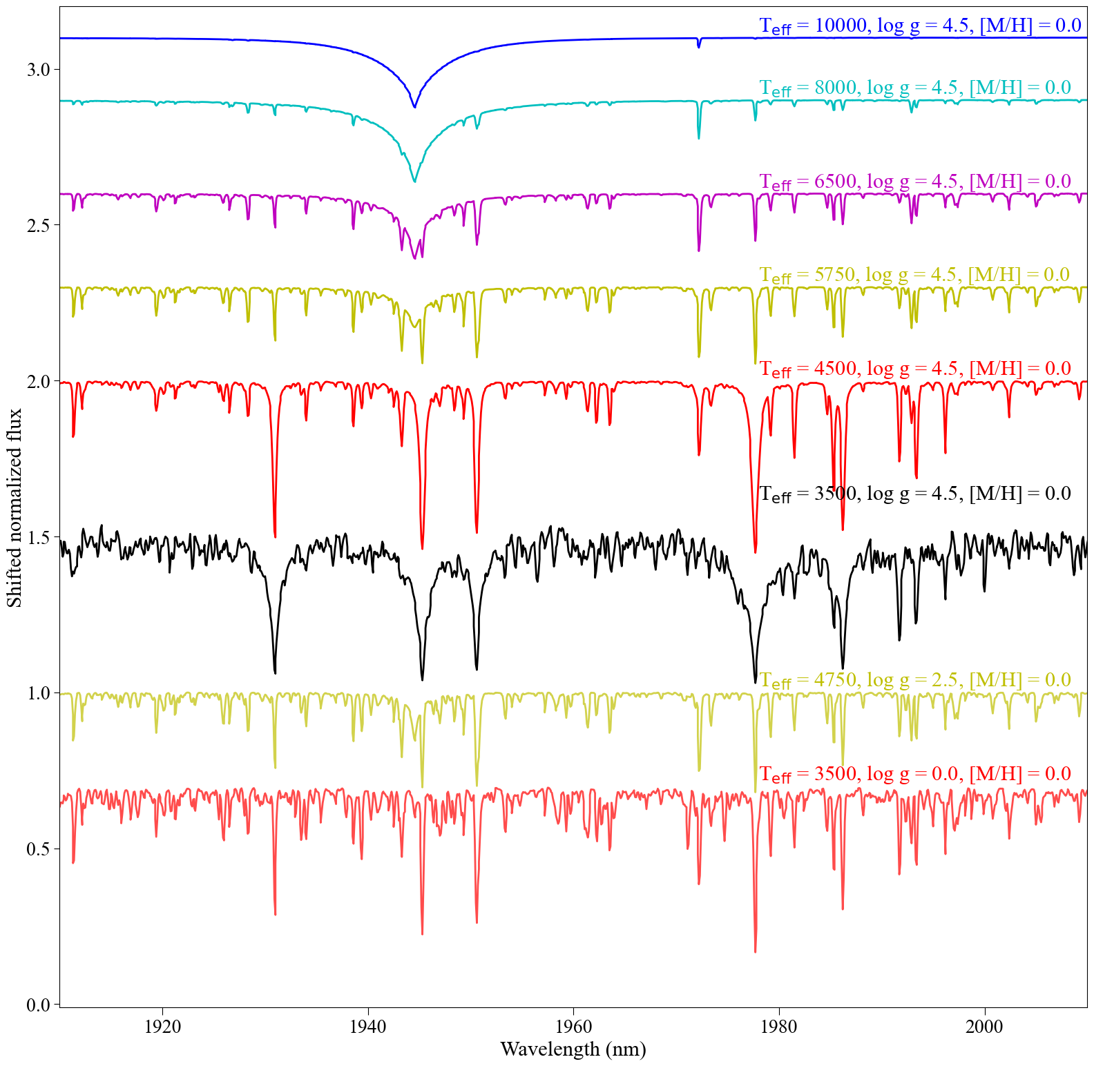

Slide 10
Available species: Mg, Si, Ca, Fe, with less confidence: Na, Ti, V, O (OH), C? (CO), N? (CN)

Slide 11
Overview
We generate 20000 random synthetic spectra with random T_{eff}, log g, [M/H], v_{rad} and SNR and re-derived their radial velocity.
Based on these tests we recommend to use the 1910 – 2010 nm region where strong Fe and Ca lines across a large parameter space help measure accurate and precise radial velocities.
Backup option could be the 1430 – 1530 nm region, but there are multiple good options for the central wavelength between 1200 and 1600 nm.
It is worth doing a new analysis in 1 nm steps and finer sampling of spectra and going from 1200 nm to 2100 nm.
How well could we measure T_{eff}, log g, [M/H], and abundances from the 1910 – 2010 nm region?

